Slide 1
CPU Scheduling
Dept. of Information Technology,
Jadavpur University, Kolkata

Slide 2
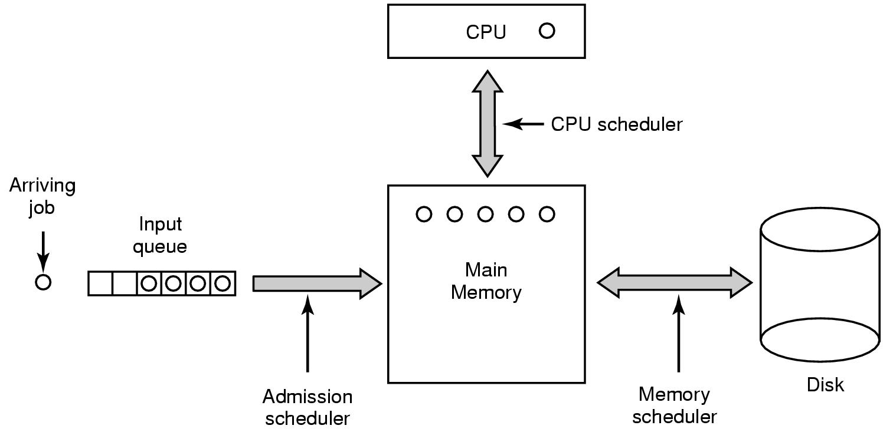
Scheduling—Basic Concept
Three level scheduling

Slide 3

CPU Scheduling
Basic Concept
  Maximum CPU utilization obtained with multiprogramming
  CPU–I/O Burst Cycle – Process execution consists of a cycle of CPU execution and I/O wait
  CPU burst distribution

Slide 4


Scheduling
Bursts of CPU usage alternate with periods of I/O wait
  a CPU-bound process
  an I/O bound process

Slide 5
CPU Scheduler
Selects from among the processes in memory that are ready to execute, and allocates the CPU to one of them
CPU scheduling decisions may take place when a process:
  1. Switches from running to waiting state
  2. Switches from running to ready state
  3. Switches from waiting to ready
  4. Terminates
Scheduling under 1 and 4 is non-preemptive
All other scheduling is preemptive

Slide 6

Dispatcher
Dispatcher module gives control of the CPU to the process selected by the short-term scheduler; this involves:
  switching context
  switching to user mode
  jumping to the proper location in the user program to restart that program
Dispatch latency – time it takes for the dispatcher to stop one process and start another running

Slide 7
Scheduling Criteria
CPU utilization
  keep the CPU as busy as possible
Throughput
  # of processes that complete their execution per time unit
Turnaround time
  amount of time to execute a particular process
Waiting time
  amount of time a process has been waiting in the ready queue
Response time
  amount of time it takes from when a request was submitted until the first response is produced, not output (for time-sharing environment)

Slide 8
First Come First Serve(FCFS) Scheduling
Process Burst Time
P₁ 24
P₂ 3
P₃ 3
Suppose that the processes arrive in the order: P₁ , P₂ , P₃
The Gantt Chart for the schedule is:
P₁
P₂
P₃
0
24
27
30
Waiting time for P₁ = 0; P₂ = 24; P₃ = 27
Average waiting time: (0 + 24 + 27)/3 = 17

Slide 9
FCFS Scheduling (Cont.)
Suppose that the processes arrive in the order
P₂ , P₃ , P₁
The Gantt chart for the schedule is:
P₂
P₃
P₁
0
3
6
30
Waiting time for P₁ = 6; P₂ = 0; P₃ = 3
Average waiting time: (6 + 0 + 3)/3 = 3
Much better than previous case
Convoy effect→ short process behind long process
Implementation

Slide 10
Shortest Job First(SJF) Scheduling
Associate with each process the length of its next CPU burst.
Use these lengths to schedule the process with the shortest time
Also known as the Shortest-Remaining-Time-First (SRTF)
Two schemes:
  nonpreemptive – once CPU given to the process it cannot be preempted until completes its CPU burst
  preemptive – if a new process arrives with CPU burst length less than remaining time of current executing process, preempt.

Slide 11
Example of Non-preemptive SJF
Process Arrival Time Burst Time
P₁ 0.0 7
P₂ 2.0 4
P₃ 4.0 1
P₄ 5.0 4
SJF (non-preemptive)
P₁
P₃
P₂
P₄
0
3
7
8
12
16
Average waiting time = (0 + 6 + 3 + 7)/4 = 4

Slide 12
Example of Preemptive SJF
Process Arrival Time Burst Time
P₁ 0.0 7
P₂ 2.0 4
P₃ 4.0 1
P₄ 5.0 4
SJF (preemptive)
P₁
P₂
P₃
P₂
P₄
P₁
0
2
4
5
7
11
16
Average waiting time = (9 + 1 + 0 +2)/4 = 3
SJF is optimal – gives minimum average waiting time for a given set of processes

Slide 13
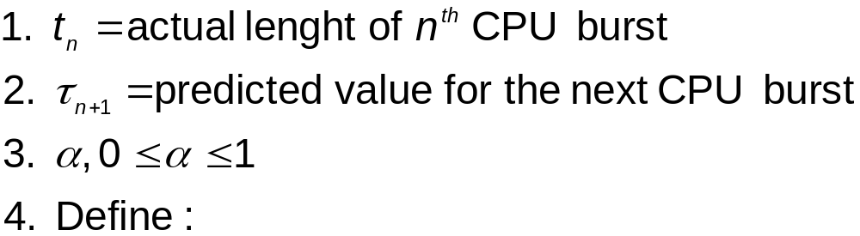
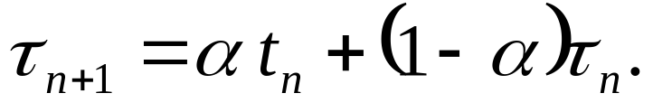
Determining Length of Next CPU Burst
Can only estimate the length
Can be done by using the length of previous CPU bursts, using exponential averaging

Slide 14

Histogram of CPU Burst Time

Slide 15

Predicting Length of Next CPU Burst

Slide 16
Example of Exponential Averaging
α =0
  τ_{n+1} = τ_{n}
  Recent history does not count (assumed to old and irrelevant)
α =1
  τ_{n+1} = t_{n}
  Only the actual last CPU burst counts (recent value is assumed to be instantaneous)
If we expand the formula, we get:
    τ_{n+1} = α t_{n}+(1 - α)α t_{n -1} + …
    +(1 - α )j α t_{n -j} + …
    +(1 - α )n +1 τ₀
Since both α and (1 - α) are less than or equal to 1, each successive term has less weight than its predecessor

Slide 17
Priority Scheduling
A priority (an integer) is associated with each process
The CPU is allocated to the process with the highest priority (smallest integer ≡ highest priority)
  Preemptive
  Nonpreemptive
SJF is a priority scheduling where priority is the predicted next CPU burst time
Problem ≡ Starvation – low priority processes may never execute
Solution ≡ Aging – as time progresses increase the priority of the process

Slide 18
Round Robin(RR) Scheduling
Each process gets a small unit of CPU time (time quantum), usually 10-100 milliseconds.
After this time has elapsed, the process is preempted and added to the end of the ready queue.
If there are n processes in the ready queue and the time quantum is q, then each process gets 1/n of the CPU time in chunks of at most q time units at once.
No process waits more than (n-1)q time units.
Performance
  q large ⇒ FIFO
  q small ⇒ q must be large with respect to context switch, otherwise overhead is too high

Slide 19
Example of RR Scheduling
Time quantum=20
Process Burst Time
P₁ 53
P₂ 17
P₃ 68
P₄ 24
The Gantt chart is:
Typically, higher average turnaround than SJF, but better response
P₁
P₂
P₃
P₄
P₁
P₃
P₄
P₁
P₃
P₃
0
20
37
57
77
97
117
121
134
154
162

Slide 20

Time Quantum and Context Switch Time

Slide 21

Turnaround Time and Time Quantum

Slide 22
Multilevel Queue Scheduling
Ready queue is partitioned into separate queues:
  Example 1
    foreground (interactive)
    background
  Example 2
    System
    Interactive
    Interactive editing
    Batch
    student
Each queue has its own scheduling algorithm
  foreground – RR
  background – FCFS

Slide 23

Multilevel Queue Scheduling

Slide 24
Multilevel Queue Scheduling
Scheduling must be done between the queues
  Fixed priority scheduling
    serve all from foreground then from background
      —Possibility of starvation.
  Time slice
    each queue gets a certain amount of CPU time which it can schedule amongst its processes;
    e.g., 80% to foreground in RR and 20% to background in FCFS

Slide 25
Multi-Level Feedback Queue
A process can move between the various queues
  aging can be implemented this way
Multilevel-feedback-queue scheduler defined by the following parameters:
  number of queues
  scheduling algorithms for each queue
  method used to determine when to upgrade a process
  method used to determine when to demote a process
  method used to determine which queue a process will enter when that process needs service

Slide 26

Example of Multilevel Feedback Queue
Three queues:
  Q0 – RR with time quantum 8 milliseconds
  Q1 – RR time quantum 16 milliseconds
  Q2 – FCFS
Scheduling
  A new job enters queue Q0 which is served RR. When it gains CPU, job receives 8 milliseconds. If it does not finish in 8 milliseconds, job is moved to queue Q1.
  At Q1 job is again served RR and receives 16 additional milliseconds. If it still does not complete, it is preempted and moved to queue Q2.

Slide 27
Multiple Processor Scheduling
CPU scheduling more complex when multiple CPUs are available
Homogeneous processors within a multiprocessor
  Any available processor can be used to run any process
Heterogeneous processors
  program complied must run on that processor

Slide 28
Multiple Processor Scheduling
Load sharing
  Use separate queue for each processor
    One could be idle while another was very busy
  Use Common ready queue
    Each processor picks a process
      may result inconsistency
    Use one processor as scheduler
      creates master-slave relationship
Asymmetric multiprocessing
  only one processor accesses the system data structures
  Others executes user processes
  alleviating the need for data sharing—avoid inconsistency

Slide 29
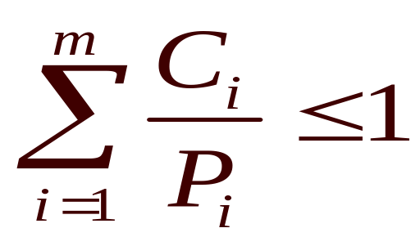
Real Time Scheduling
Hard real-time systems
  required to complete a critical task within a guaranteed amount of time
Soft real-time systems
  requires that critical processes receive priority over less fortunate ones
Schedulable real-time system
Given
  m events (processes)
  process i occurs within period P_{i} and requires C_{i} seconds
Then the load can be handled only if

Slide 30
Algorithm Evaluation
Criteria used in selecting an algorithm
  Maximum CPU utilization under the constraint the maximum response time is 1 second
  Maximum throughput such that average turnaround time linearly proportional to execution time
Deterministic Modeling
  Evaluates using a predetermined work load
    can not cope with the dynamic behavior of the system
Queueing Models
  Uses mathematical analysis
    Complicated—hence used unrealistic assumptions
    Uses some assumptions—that may not occur
    An approximation of real system and accuracy is questionable
Simulation
  Expensive—takes hours of computer time

